Slide 1



Slide 2


AGENDA
Introduction
Data Model v.3
Engineering Process - Explained
Plans Moving Forward
OPTIMAL SOFTWARE SOLUTIONS

Slide 3
AGENDA
Introduction
Introduction
Data Model v.3
Engineering Process - Explained
Plans Moving Forward
Project: OSS-NCR
Previously Discussed: Data Model Revision and Insight of NCR process.
Presentation Content: Engineering Section Addition - Data Model & Prototype Revision

Slide 4
AGENDA
Introduction
Introduction
Data Model v.3
Engineering Process - Explained
Plans Moving Forward
Project: OSS-NCR
Previously Discussed: Data Model Revision and Insight of NCR process.
Presentation Content: Engineering Section Addition - Data Model & Prototype Revision

Slide 5
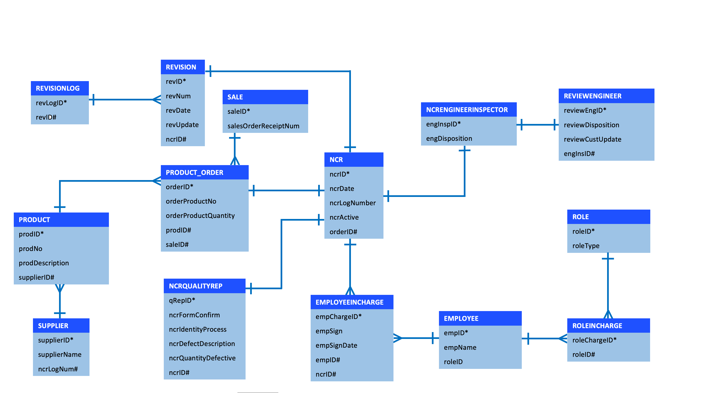
Data model v. 2
Introduction
QUALITY_DEPT
quaDeptID*
quaDeptName
quaDeptDate
>
Project: OSS-NCR
Previously Discussed: Data Model Revision and Insight of NCR process.
Presentation Content: Engineering Section Addition - Data Model & Prototype Revision
NCRSTATUS
ncrStatID*
ncrStat
ncrLogNum#
>
OPS_INSPECTION
opsInsID*
opsInsAcceptable
ncrLogNum#
opsInsDate
opsID#
opsName
>
>
>
OPSDECISION
opsDesID*
opsDes
ncrLogNum#
OPS_INSPECTOR
opsID*
opsName
opsDate

Slide 6
AGENDA
QUALITY_DEPT
quaDeptID*
quaDeptName
quaDeptDate
>
Introduction
Data Model v.2
The OSS Effect (Storyboard)
The Initial Development
Data model v. 3
NCRSTATUS
ncrStatID*
ncrStat
ncrLogNum#
>
OPS_INSPECTION
opsInsID*
opsInsAcceptable
ncrLogNum#
opsInsDate
opsID#
opsName
>
>
>
OPSDECISION
opsDesID*
opsDes
ncrLogNum#
OPS_INSPECTOR
opsID*
opsName
opsDate

Slide 7
ENGINEERING PROCESS –
EXPLAINED
QUALITY INSPECTOR
COMPLETES AND
SENDS NCR TO THE ENGINEER
ENGINEER RECIEVES NCR
ON HIS PORTAL AND
GETS NOTIFIED
ENGINEER COMPLETES
RESPECTIVE SECTION
AND SENDS NCR TO
PURCHASING SECTOR
PURCHASING SECTOR TO
MOVE FORWARD WITH
THE NCR’S PROCESS

Slide 8
ENGINEERING PROCESS –
EXPLAINED
QUALITY INSPECTOR
COMPLETES AND
SENDS NCR TO THE ENGINEER
ENGINEER RECIEVES NCR
ON HIS PORTAL AND
GETS NOTIFIED
ENGINEER COMPLETES
RESPECTIVE SECTION
AND SENDS NCR TO
PURCHASING SECTOR
PURCHASING SECTOR TO
MOVE FORWARD WITH
THE NCR’S PROCESS

Slide 9
ENGINEERING PROCESS –
EXPLAINED
QUALITY INSPECTOR
COMPLETES AND
SENDS NCR TO THE ENGINEER
ENGINEER RECIEVES NCR
ON HIS PORTAL AND
GETS NOTIFIED
ENGINEER COMPLETES
RESPECTIVE SECTION
AND SENDS NCR TO
PURCHASING SECTOR
PURCHASING SECTOR TO
MOVE FORWARD WITH
THE NCR’S PROCESS

Slide 10
ENGINEERING PROCESS –
EXPLAINED
QUALITY INSPECTOR
COMPLETES AND
SENDS NCR TO THE ENGINEER
ENGINEER RECIEVES NCR
ON HIS PORTAL AND
GETS NOTIFIED
ENGINEER COMPLETES
RESPECTIVE SECTION
AND SENDS NCR TO
PURCHASING SECTOR
PURCHASING SECTOR TO
MOVE FORWARD WITH
THE NCR’S PROCESS

Slide 11
ENGINEERING PROCESS –
EXPLAINED
Plans moving forward
QUALITY INSPECTOR
COMPLETES AND
SENDS NCR TO THE ENGINEER
ENGINEER RECIEVES NCR
ON HIS PORTAL AND
GETS NOTIFIED
Collect and implement feedback from this session into the next prototype revision.
Incorporate new additions to the web application as per requests.
Refine interface and UI of the web application.
ENGINEER COMPLETES
RESPECTIVE SECTION
AND SENDS NCR TO
PURCHASING SECTOR
PURCHASING SECTOR TO
MOVE FORWARD WITH
THE NCR’S PROCESS

Slide 12
ENGINEERING PROCESS –
EXPLAINED
Plans moving forward
QUALITY INSPECTOR
COMPLETES AND
SENDS NCR TO THE ENGINEER
ENGINEER RECIEVES NCR
ON HIS PORTAL AND
GETS NOTIFIED
Collect and implement feedback from this session into the next prototype revision.
Incorporate new additions to the web application as per requests.
Refine interface and UI of the web application.
ENGINEER COMPLETES
RESPECTIVE SECTION
AND SENDS NCR TO
PURCHASING SECTOR
PURCHASING SECTOR TO
MOVE FORWARD WITH
THE NCR’S PROCESS

Slide 13
OPTIMAL SOFTWARE SOLUTIONS
THANK YOU FOR YOUR TIME

